Slide 1

BsidesKC 2023
Learn to Solder Village

Slide 2
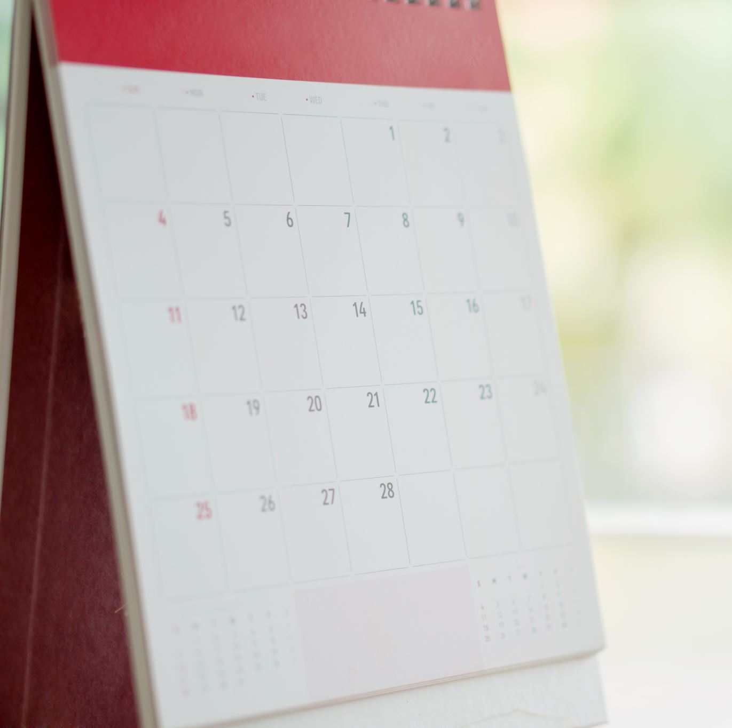
Schedule
Village setup – 4PM-6:30PM Friday, October 7th
Village training/prep – 8AM Saturday, October 8th
Village Opens: 10AM
Village Close: 5PM

Slide 3
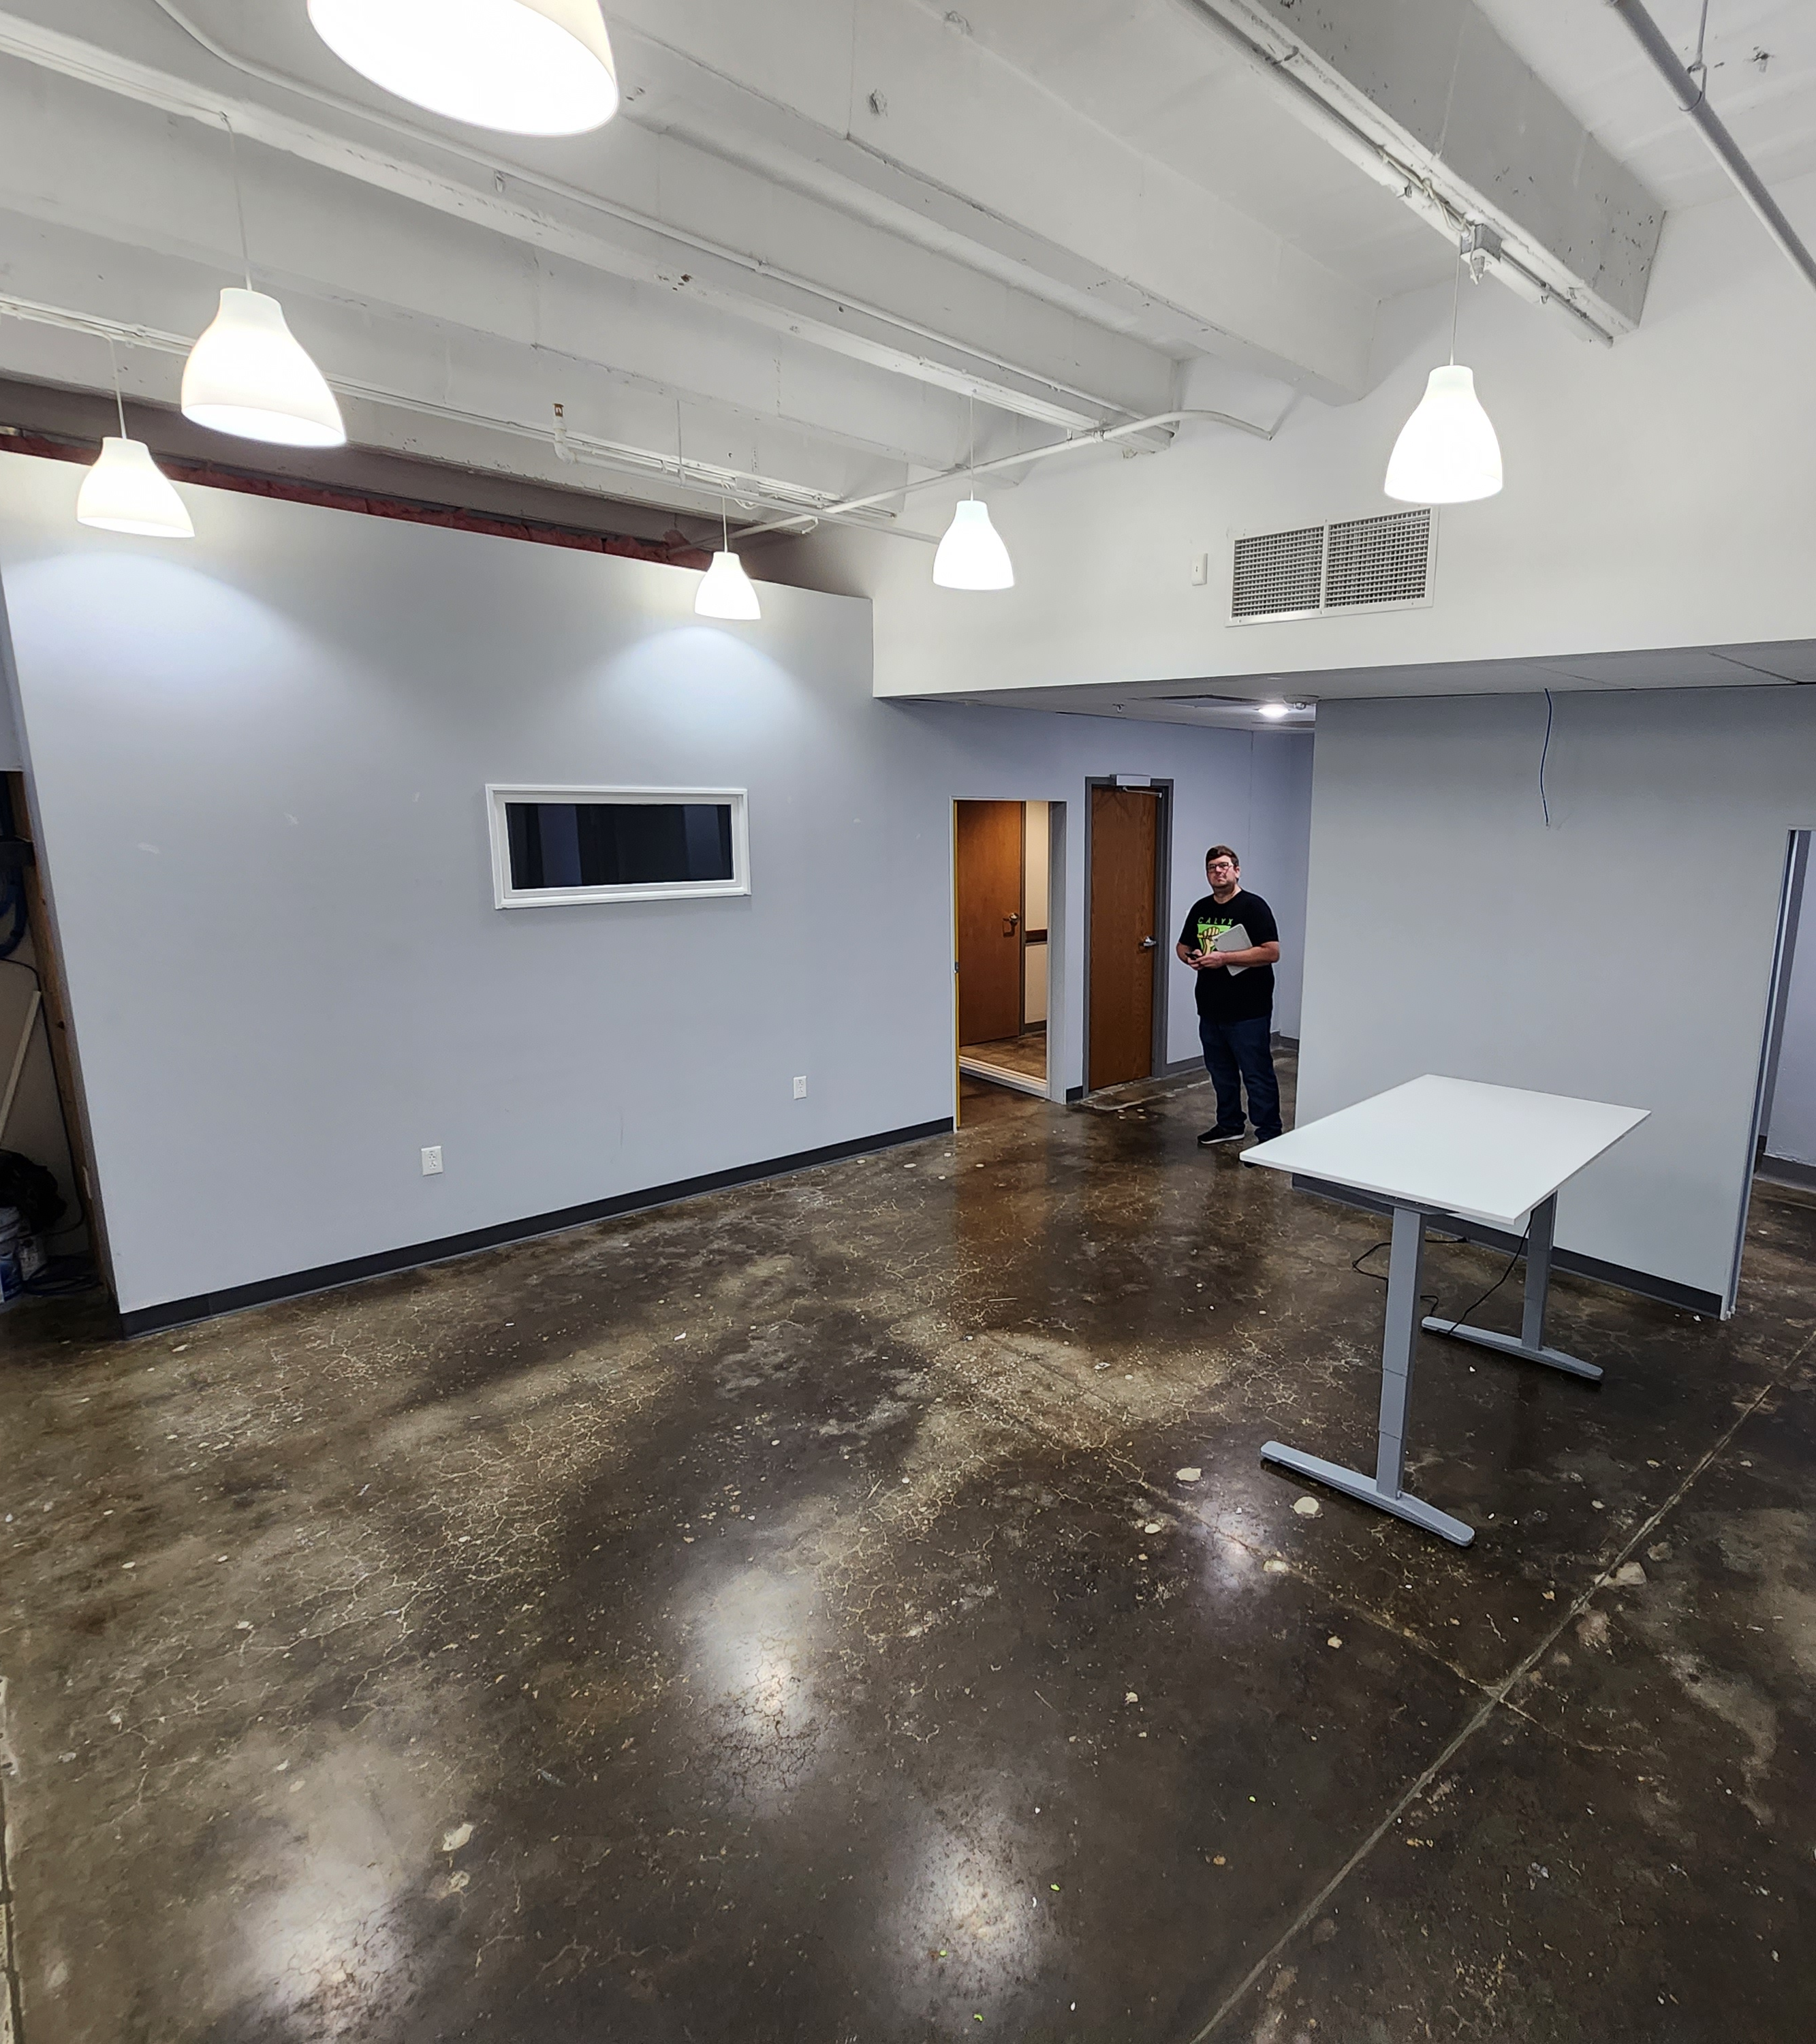
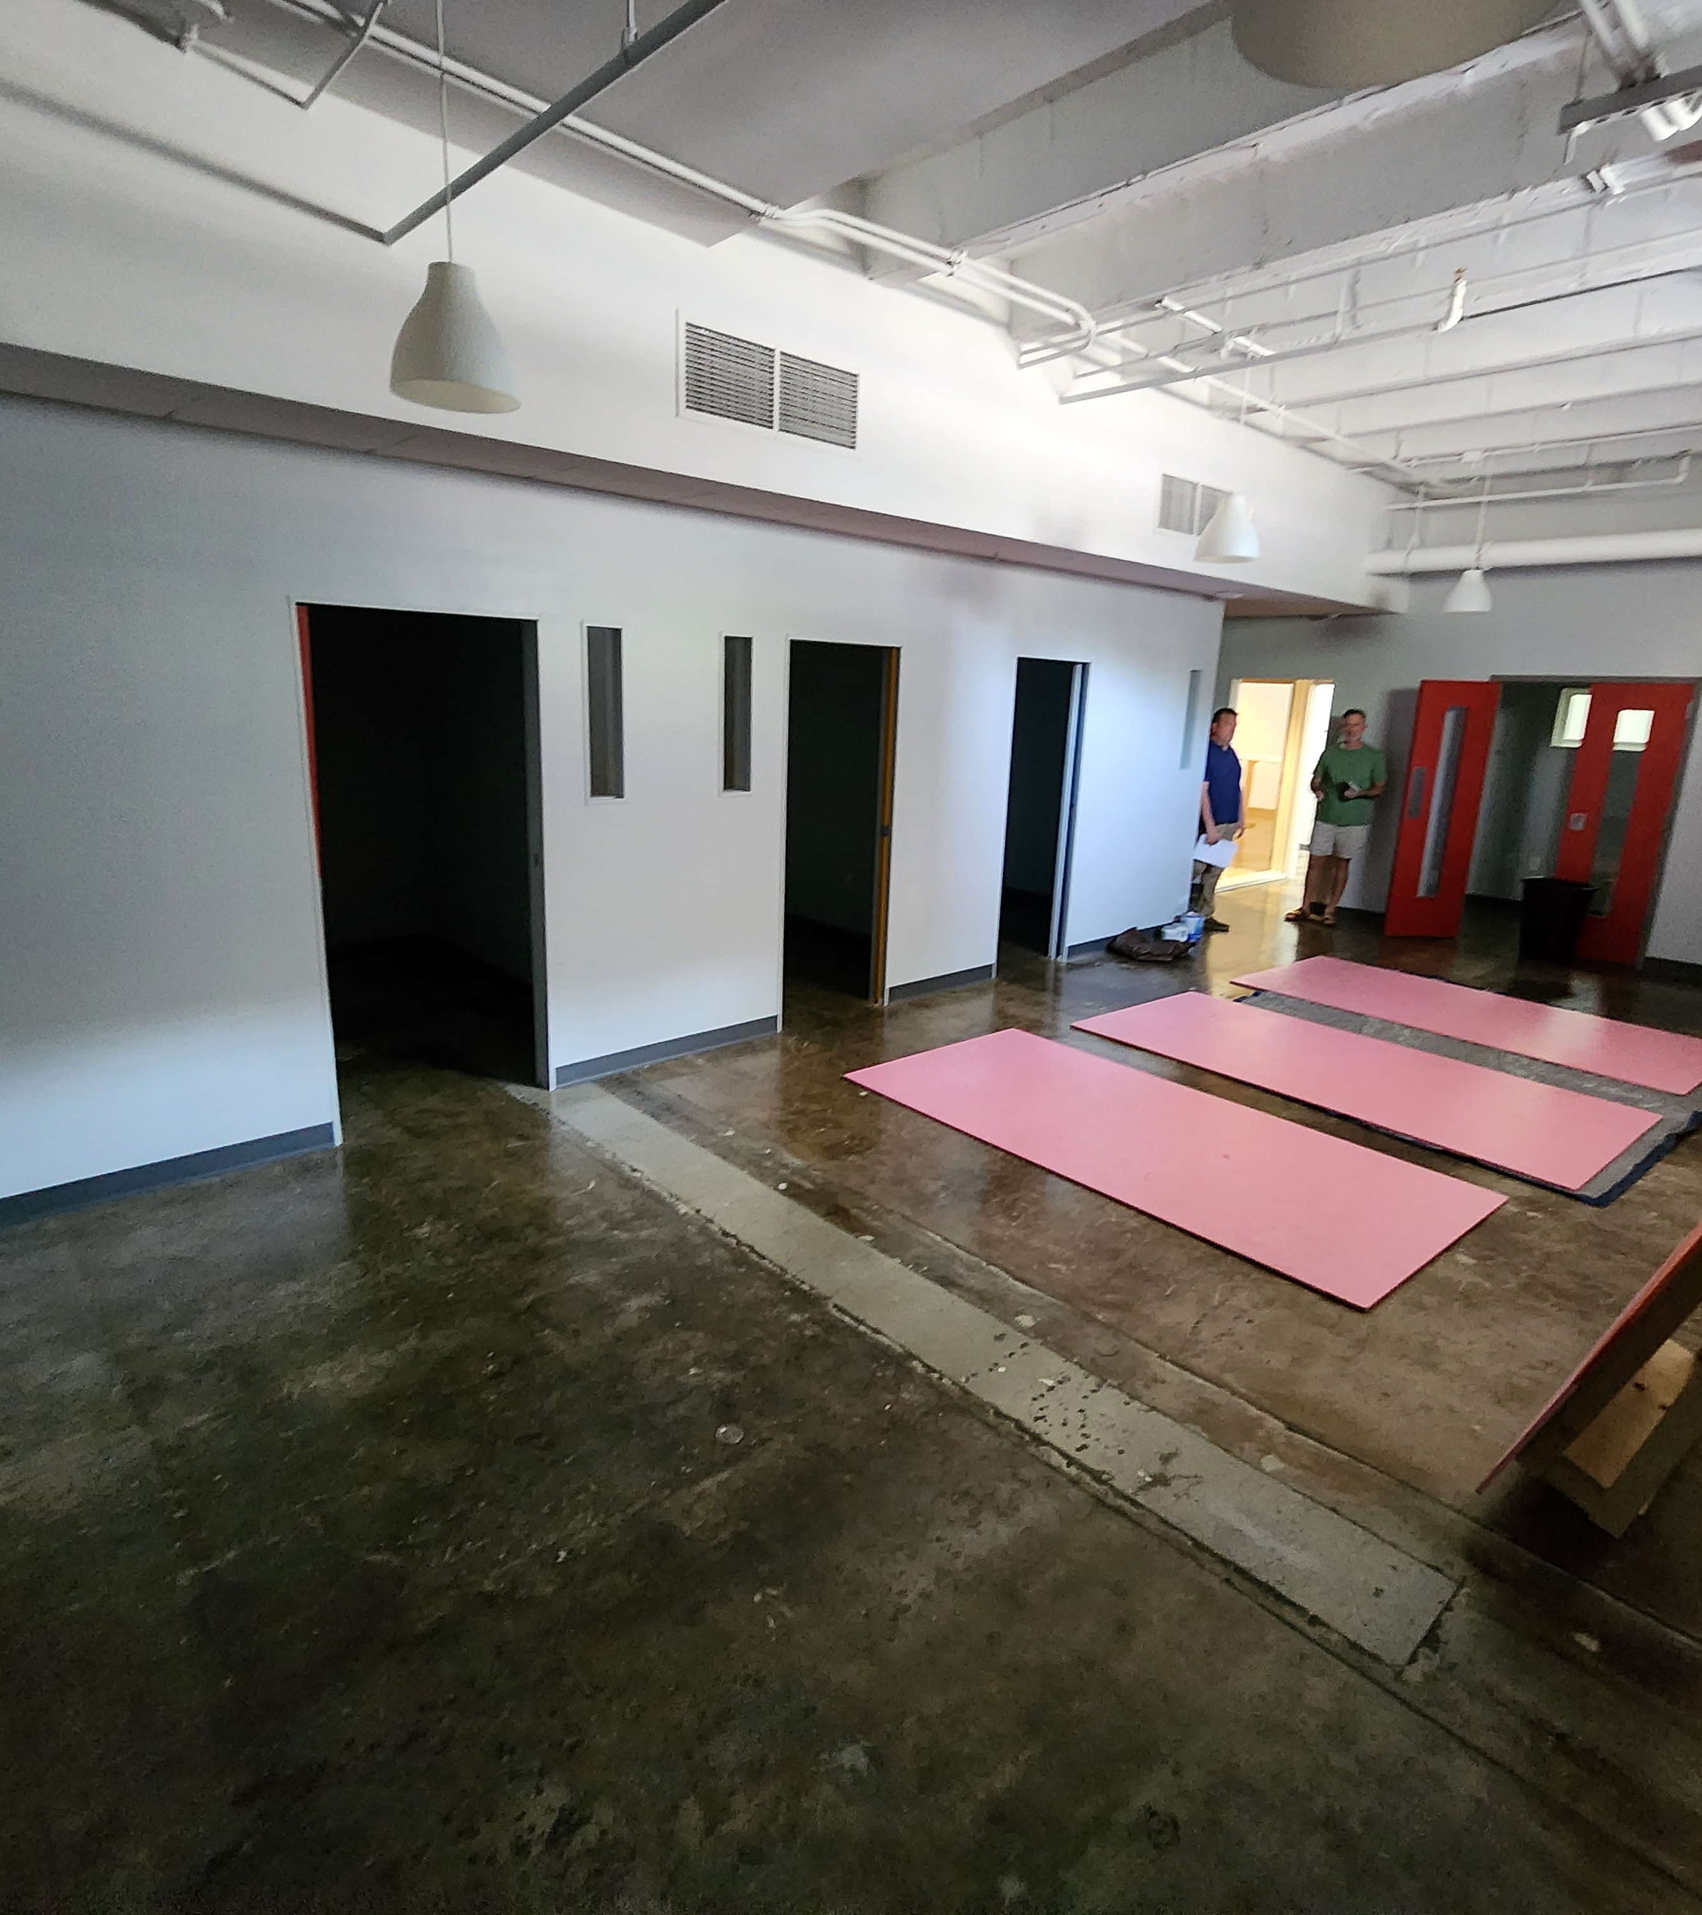
Badge Assistance / CTF
Primary Learn to Solder Room
Left Room
Right Room

Slide 4
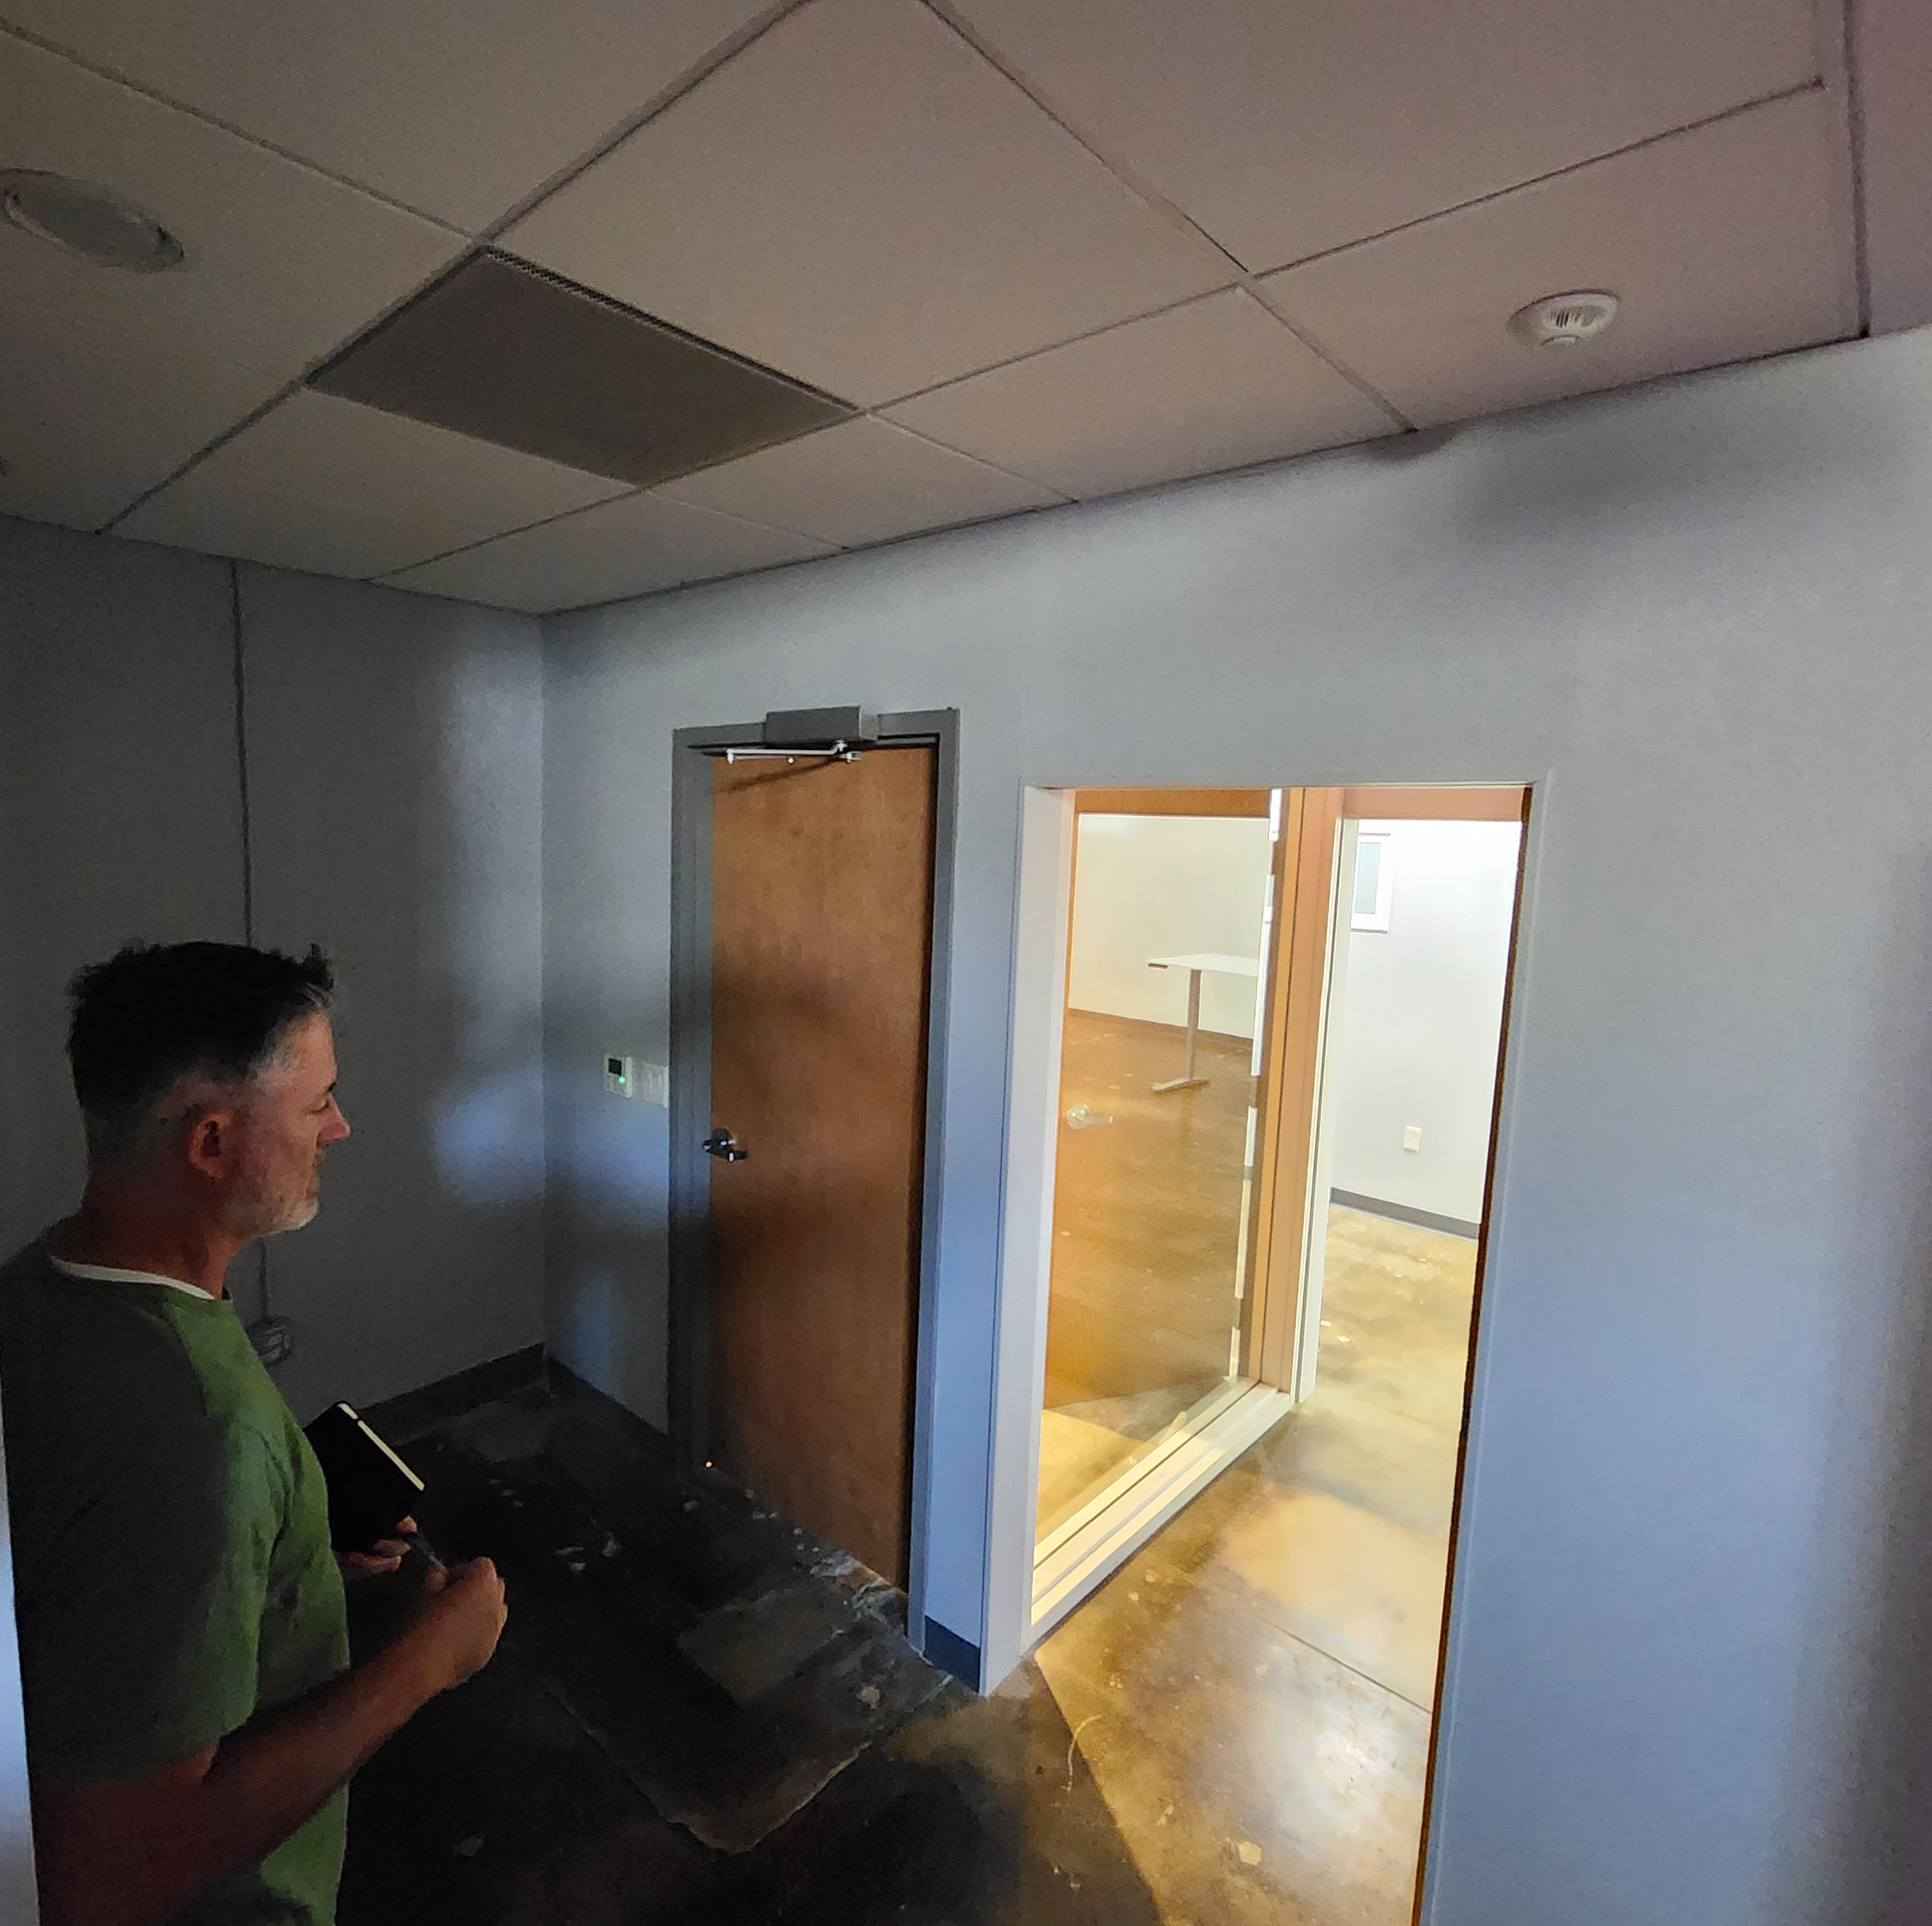
Traffic Control
Room(s) have a common path (up stairs) to enter with two different doors
There is a throughway to go between them
Entrance should be through right room door
Exit should be through left room door (via throughway)
Room to right will be the primary Learn to Solder Room
Room to left will be the Badge support / CTF room

Slide 5
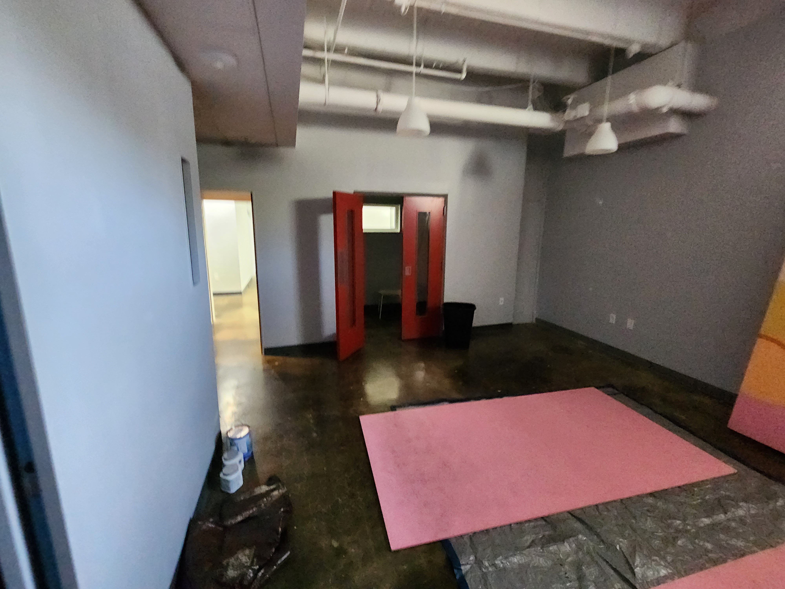
Closet Room
Storage of supplies
Table for village support

Slide 6

Projects
Flashlight Learn to Solder Kit
$5 suggested donation
Min-USB Learn to Solder Kit (CTF)
Community Solder Art Project
Assorted electrical components to solder on a KC frame (made by C. Fugate)
No SAO’s this year (by @badgepirates)
Northwest Arkansas (NWA) typically brings some

